Slide 1
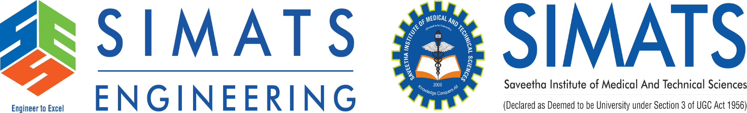
CAPSTONE PROJECT
CSA0405- OPERATION SYSTEMS
Freeze Guard:An AI-Driven Intelligent Framework for
Real-Time Application Freeze Detection, Root Cause Analysis and Automatic Recovery System
Guided by:
Dr. Priskilla Angel Rani J
Presented by:
192425143 - K.KEERTHANA SAI 192411227 - NANDA DIMPLE BLOSSOM
192521338 -BHAGYA SHREE S
192511056 - V VAISHNAVI
192521052 - B JANANI

Slide 2


ABSTRACT
Develops an AI-Based Application Freeze Recovery System to detect and recover frozen applications instead of immediately terminating them.
Continuously monitors CPU usage, memory usage, process state, and system resources using Operating System concepts.
Uses AI techniques to identify the root cause of application freezes, such as memory leaks, deadlocks, or high CPU utilization.
Performs intelligent recovery actions like suspending, resuming, changing process priority, or safely restarting the application to reduce data loss.
Maintains system logs and recovery history to improve future predictions and enhance overall system reliability and performance.

Slide 3
INTRODUCTION
Modern applications often freeze due to high CPU usage, memory leaks, deadlocks, resource contention, or disk I/O delays, affecting system performance.
Existing solutions generally force users to end the application, which can lead to the loss of unsaved data and interruption of ongoing tasks.
The proposed AI-Based Application Freeze Recovery System continuously monitors application behavior using Operating System resource management techniques.
By combining Operating System concepts with AI, the proposed system improves application reliability, minimizes downtime, and enhances the overall user experience.

Slide 4
PROBLEM STATEMENT
Critical applications used in hospitals, banks, offices, and educational institutions often freeze due to high CPU usage, memory leaks, deadlocks, or disk I/O bottlenecks, interrupting important tasks.
Users usually force-close unresponsive applications, which can result in the loss of unsaved data, reduced productivity, and service interruptions.
Current operating systems can identify that an application is "Not Responding", but they cannot automatically determine the exact cause or recover the application intelligently.
An AI-Based Application Freeze Recovery System is needed to continuously monitor applications, identify the root cause of freezes, and perform safe recovery actions, reducing downtime and preventing data loss.

Slide 5
OBJECTIVE
.
.
To continuously monitor running applications and system resources (CPU, memory, disk I/O, and process state) to detect freeze conditions at an early stage.
To identify the root cause of application freezes using AI by analyzing system and process behavior, such as memory leaks, deadlocks, and high CPU usage.
To perform intelligent recovery actions like suspending, resuming, adjusting process priority, or safely restarting applications to reduce downtime and prevent unnecessary termination.
To improve system reliability and user productivity by minimizing data loss, maintaining recovery logs, and enhancing the overall performance of application management.

Slide 6


EXISTING VS PROPOSED SYSTEM
Detects only "Not Responding".
Requires manual task termination.
No root cause analysis. Causes possible data loss.
No automatic recovery.
Limited system monitoring.
Monitors applications continuously.
AI identifies freeze causes.
Performs smart recovery actions. Reduces data loss.
Maintains recovery logs.
Improves system reliability.

Slide 7
MODULES
Module 1: Process & Resource Monitoring
Module 2: Freeze Cause Analysis using AI
Module 3: Intelligent Recovery Engine
Module 4: Memory & Resource Optimization
Module 5: Logging, Learning & Prediction Dashboard

Slide 8
MODULE 1: PROCESS & RESOURCE MONITORING
Continuous observation of applications and system resources
Running Applications
Process Monitor
Resource Metrics
Freeze Detection
Monitors CPU usage, memory usage, disk I/O and process state.
Tracks application behaviour continuously in real time.
Detects abnormal resource usage and unresponsive states early.
CPU ████████░░ 80%
Memory ██████░░░░ 60%
Process ● RUNNING / NOT RESPONDING
10

Slide 9
MODULE 2: FREEZE CAUSE ANALYSIS USING AI
Identifying why an application becomes unresponsive
Freeze Detected
Collect Metrics
AI Analysis
Root Cause
High CPU Utilization
Memory Leak
Deadlock / Resource Contention
Disk I/O Bottleneck
AI analyses process and resource behaviour to classify likely freeze causes.
The identified cause becomes the input for selecting an appropriate recovery action.
11

Slide 10
MODULE 3: INTELLIGENT RECOVERY ENGINE
Selecting a recovery action instead of immediately terminating the process
Freeze Cause + Process State
Suspend
Resume
Adjust Priority
Safe Restart
Chooses a suitable action based on the detected condition.
Avoids unnecessary force-close operations and aims to reduce downtime and data loss.
12

Slide 11
MODULE 4: MEMORY & RESOURCE OPTIMIZATION
Keeping system resources balanced after recovery
Resource Pressure
Analyze Usage
Optimize / Prioritize
Stable System
CPU
High → Balanced
Memory
Leak → Controlled
Disk I/O
Bottleneck → Reduced
Helps maintain application performance and system reliability after recovery.
13

Slide 12
MODULE 5: LOGGING, LEARNING
& PREDICTION DASHBOARD
LIVE APPLICATION MONITOR
Recovery Logs & History
Application
CPU
Memory
State
Action
App A
82%
68%
Frozen
Resume
Prediction / Learning
App B
31%
45%
Running
—
App C
91%
77%
Frozen
Priority
Dashboard Visualization
14

Slide 13
RESULT
Early Detection
Cause Identification
Freeze conditions are identified from process and resource behaviour.
Likely causes such as high CPU, memory leaks,
deadlocks and I/O bottlenecks are analysed.
Smart Recovery
Reliability
The system selects suspend, resume, priority adjustment or safe restart.
Recovery history and monitoring improve reliability
and reduce unnecessary termination.
15

Slide 14
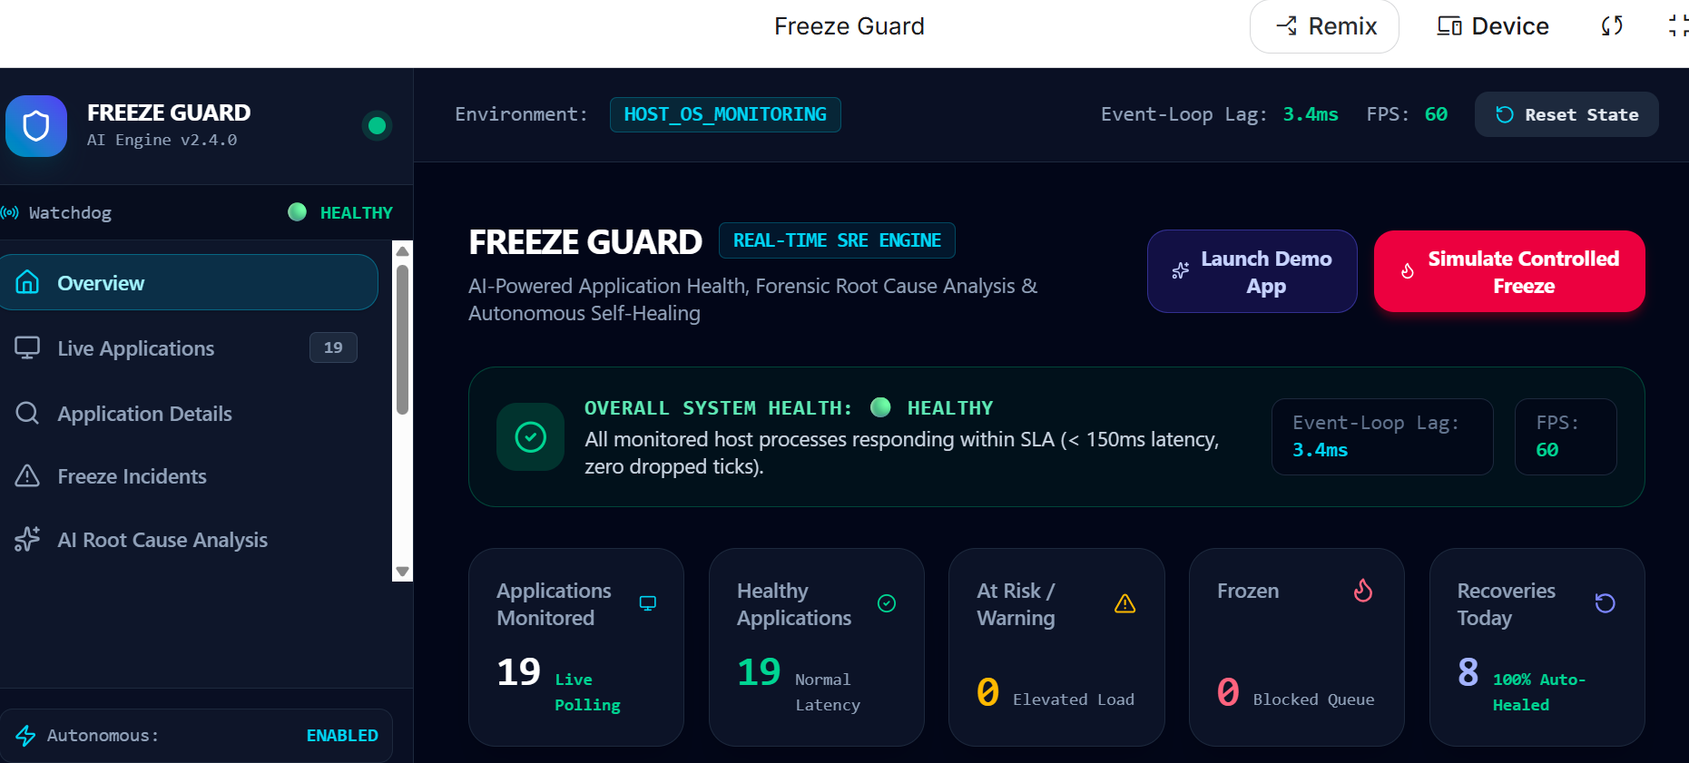
OUTPUT
16

Slide 15
REFERENCES
H. Chen et al. (2022). "AI-Powered Error Detection and Recovery for Distributed Systems". Proceedings of the 2022 ACM SIGMETRICS, 50(3). Available at: https://doi.org/10.1145/3539587.3539593
S. S. Iyer et al. (2020). "AI-Driven Anomaly Detection for Application Resilience". IEEE Transactions on Dependable and Secure Computing, 17(4). Available at: https://doi.org/10.1109/TDSC.2019.2910231
J. Liu et al. (2022). "Intelligent Fault Tolerance for Cloud Applications Using Machine Learning". IEEE Cloud Computing, 9(2). Available at: https://doi.org/10.1109/MCC.2022.3160143
Y. Zhang et al. (2020). "Application Failure Prediction Using Graph Convolutional Networks". IEEE Transactions on Neural Networks and Learning Systems, 31(1). Available at: https://doi.org/10.1109/TNNLS.2019.2912305
Y. LeCun et al. (2022). "Deep Learning: Techniques and Applications". Springer, 1st Edition. ISBN: 978-3030887985
17

Slide 16
CONCLUSION
Developed an AI-Based Application Freeze Recovery System that continuously monitors running applications and system resources in real time.
Implemented AI-based freeze analysis to identify causes such as high CPU usage, memory leaks, deadlocks, and resource bottlenecks.
Designed an intelligent recovery engine that performs actions like suspend, resume, priority adjustment, or safe restart to reduce application downtime.
The proposed system enhances system reliability, minimizes data loss, and improves user productivity by providing automated and efficient application recovery.

Slide 17
THANK YOU

